Slide 1
10 hard-won lessons for identifier design, provision, and reuse of identifiers for web-based life science data
BDK11-01 | Julie McMurry and Nicole Vasilevsky
Based on a preprint by Julie McMurry et al http://doi.org/10.5281/zenodo.163459

Slide 2
Learning objective
Identify best practices for design, creation, provision, maintenance, re-use and referencing of identifiers

Slide 3
What is an identifier?
An identifier is a sequence of characters that identifies an entity.
A persistent identifier (PI or PID) is a long-lasting reference to a document, file, web page, or other object. The term "persistent identifier" is usually used in the context of digital objects that are accessible over the Internet.

Slide 4
Summary of the 10 recommendations, their relevance to different kinds of actors in the landscape, current and future efforts that would help lower barriers to best practice
1. Credit any derived content using its original identifier
2. Help local identifiers travel well: document prefix and patterns
3. Design new identifiers for diverse uses by others
4. Avoid embedding meaning, or relying on it for uniqueness
5. Opt for simple, durable web resolution
6. Implement a version-management policy
7. Make URIs clear and findable
8. Do not reassign or delete identifiers
9. Document the identifiers you issue and use
10. Reference and display responsibly

Slide 5
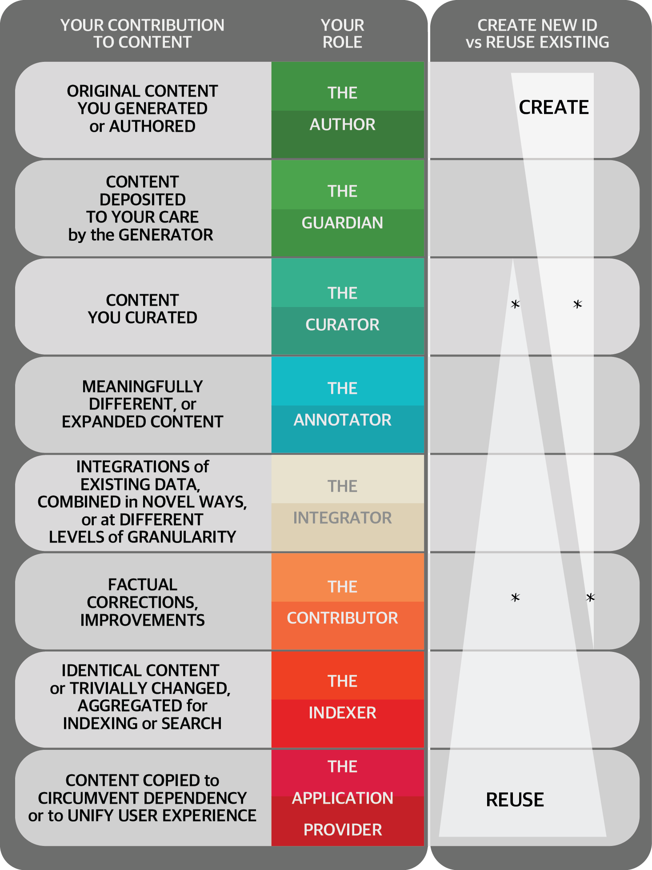
1. Credit any derived content using its original identifier
When to create new identifiers
Contributed by Julie McMurry ADD DATE

Slide 6
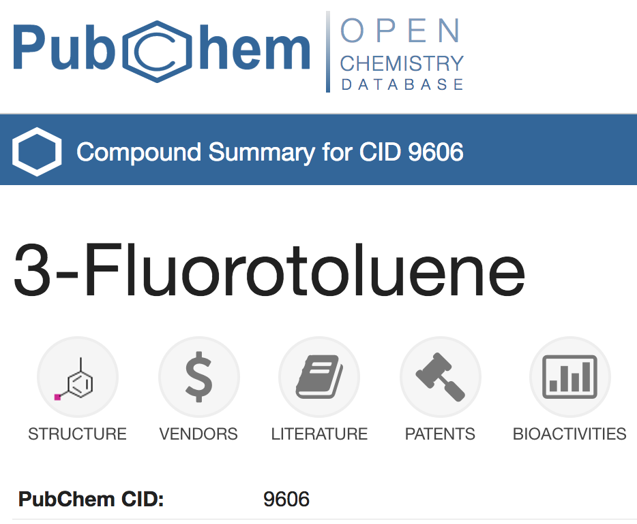

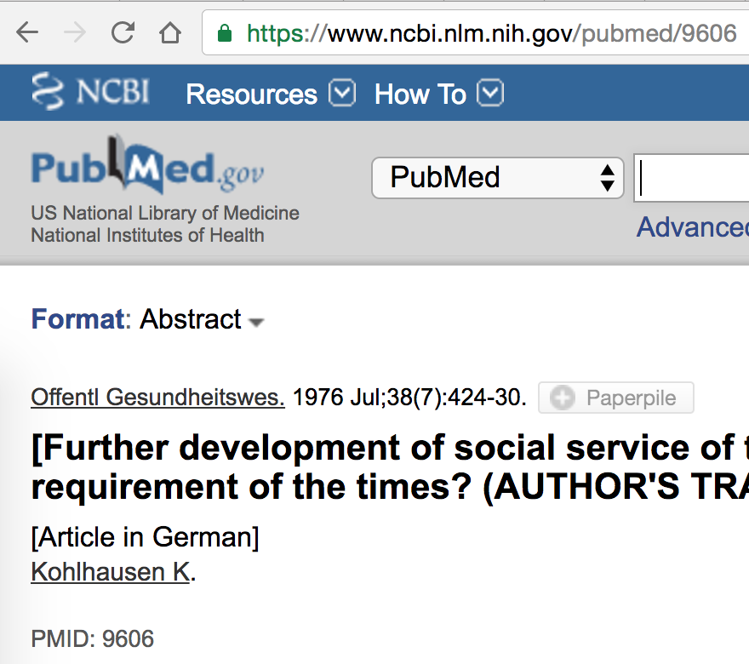
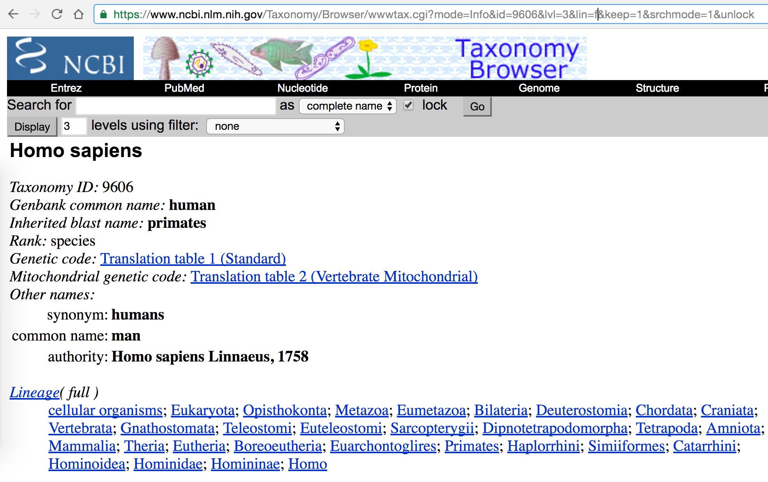
2. Help local identifiers travel well: document Prefix and http URI pattern
Local ID
Unique within the scope of a single database
Local IDs are poorly suited to facilitate data integration
A chemical …
For example,
‘9606’ corresponds to three different records just within NCBI
A publication…
A taxon…

Slide 7
2. Help local identifiers travel well: document Prefix and http URI pattern
http URIs are strings that uniquely identify individual web resources.
http URI Pros:
Can be used for machine-driven global data integration
Is a widely adopted W3C standard
Its uniqueness is ensured by a single well-established name-granting process (the DNS)
http URI Cons:
Subject to link rot (ie potentially vulnerable to generate dead links)
The length of URIs can make them unwieldy for tasks involving human readability

Slide 8
CURIES – Compact URIs
Taking the previous example 9606, there are three corresponding http URIs (more actually since the “authoritative version” of each URI is not clear.
CURIEs enable URIs to be understood and conveniently expressed
CURIES are an identifier comprised of <Prefix>:<Local ID> wherein prefix is deterministically expandable to a URI pattern which alone is the basis for the CURIE’s global uniqueness. For instance, the Prefix ‘PubChem’ can be expanded to https://pubchem.ncbi.nlm.nih.gov/compound/
https://pubchem.ncbi.nlm.nih.gov/compound/9606 ➔ PubChem:9606
https://www.ncbi.nlm.nih.gov/pubmed/9606 ➔ PMID:9606
https://www.ncbi.nlm.nih.gov/Taxonomy/Browser/wwwtax.cgi?id=9606 ➔ NCBITaxon:9606

Slide 9
3. Design new identifiers for diverse uses by others
Recommendations for designing new local identifiers
Avoid problem characters (If possible stick to letters and numbers)
Avoid problem patterns (Consider opportunities for corruption as dates, words, etc)
Document your pattern and stick to it, including case convention

Slide 10
4. Avoid embedding meaning, or relying on it for uniqueness
Minimizing the meaning embedded in identifiers makes them less vulnerable to obsoletion
Embedded meaning is never required, whether in the local identifier or in the URI.
Embedded meaning should only be considered if it is indisputable, unchangeable and also useful to the data consumer (e.g. computer-processable)
Use an entity label that is bound to the ID; only the ID is used in the http URI
Symbol | Kit^{W-v}
Name | KIT proto-oncogene receptor tyrosine kinase; viable dominant spotting
Local ID | MGI:2171276
http URI | www.informatics.jax.org/accession/MGI:1856266

Slide 11
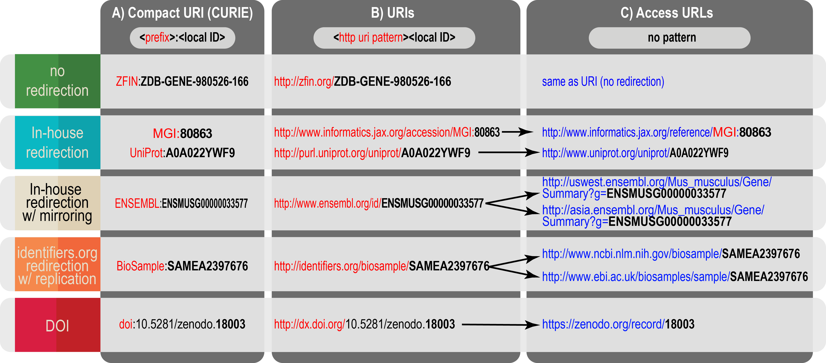
5. Opt for simple, durable web resolution

Slide 12
6. Implement a version-management policy
Recommendation for record-level versioning with URIs
Recommendation | Example (for clarity, Local ID only is shown)
Version information should follow after a dot | P12345.3
Base resource must resolve (302 redirect) to most recent version | P12345
Base resource should be deterministically convertible from version | P12345.1 to P12345
Older versions must resolve | P12345.1
Illegal or invalid version must produce an informative HTTP error code (message such as 400 ‘Bad Request’) and an HTML page explaining the error. For example identifiers.org has a page reporting “unknown collection” together with its 404 status. | P12345.302
Link from older version to current version must be provided | P12345.3
A list of all previous versions should be available | P12345 (see ‘history’ tab in user interface)
Two versions (or dates) should be comparable | http://www.uniprot.org/uniprot/P12345?version=*

Slide 13
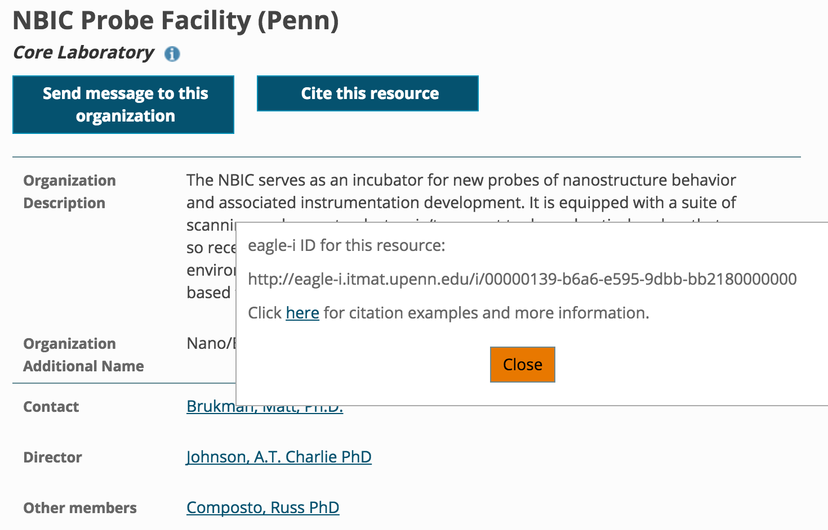
7. Make URIs clear and findable
eagle-i record-level citation widget

Slide 14
8. Do not reassign or delete identifiers
Recommendations for identifier lifecycle management
Recommended handling | Example
Obsoletion: If an entry has been removed or deprecated, the original identifier must still resolve to a ‘tombstone page’. Reasons for obsolescence should be indicated. If the obsoleted ID is replaced by another ID, the replacement must be present and also described as automatic or suggested, preferably using the ontology properties iao:replaced_by and obo:consider, respectively. The obsoleted ID must never be reassigned to another entity. A list of obsoleted IDs should be maintained. | Single obsoleted identifier: http://www.uniprot.org/uniprot/A0AV18 List of obsoleted identifiers: uniprot.org/help/deleted_accessions
Merging: When two or more identifiers are merged, a new recipient identifier should be designated as the primary (citable) one and should contain information about the legacy identifiers it encompasses. Any legacy identifiers should continue to resolve via redirection to the primary identifier. | UniProt entries Q57339 and O08022 have been merged into Q00626. Q57339 and O08022 are redirected to Q00626.
Splitting: If an identifier is split (demerged) into two or more new ones, new identifiers should be assigned to all the new entries. The legacy identifier must be marked as obsolete, but must also still resolve, providing a warning and pointers to the new ones as per above. | UniProt entry P29358 has been split into P68250 and P68251. P29358 displays a warning and links to the demerged entries: http://www.uniprot.org/uniprot/P29358

Slide 15
9. Document the identifiers you issue and use
https://cdn.pixabay.com/photo/2016/11/29/07/10/adult-1868015_960_720.jpg

Slide 16
10. Reference and display responsibly
Hyperlink external entities to their URIs or to pages/metadata containing their URIs
Reference using URIs, never access URLs
Redistributors of data should monitor their references to other sources
Report ’dead’ links to original data provider
Differentiate identifiers linked internally within your application from identifiers linked outside your application

Slide 17
Conclusion
Design
Provisioning
Documentation
Referencing

